Slide 1
SLIDE.education demo
Sample template: image, video and audio with the three question types
• Upload this file as it is: the questions are configured by themselves.
• Each option is a separate shape and the answer area is a rectangle.
• The name of each shape (Home › Select › Selection Pane) tells its role: sle:option, sle:option:correct, sle:answer:answer, sle:next.
• Keep the bottom strip free: the remaining time and the slide number are shown there.
• Animations and transitions are not used.
Start ▶
Notes:
How this template works:
- sle:answer:4|four → answer area; accepted answers separated by |.
- sle:option → option; sle:option:correct → correct option. With more than one correct option the question is multiple choice.
- sle:next / sle:prev → next / previous buttons.
- sle:autoplay (on a video or audio) → it starts playing by itself.
Everything else (times, scoring, paths, shuffling) is set later in the editor.

Slide 2
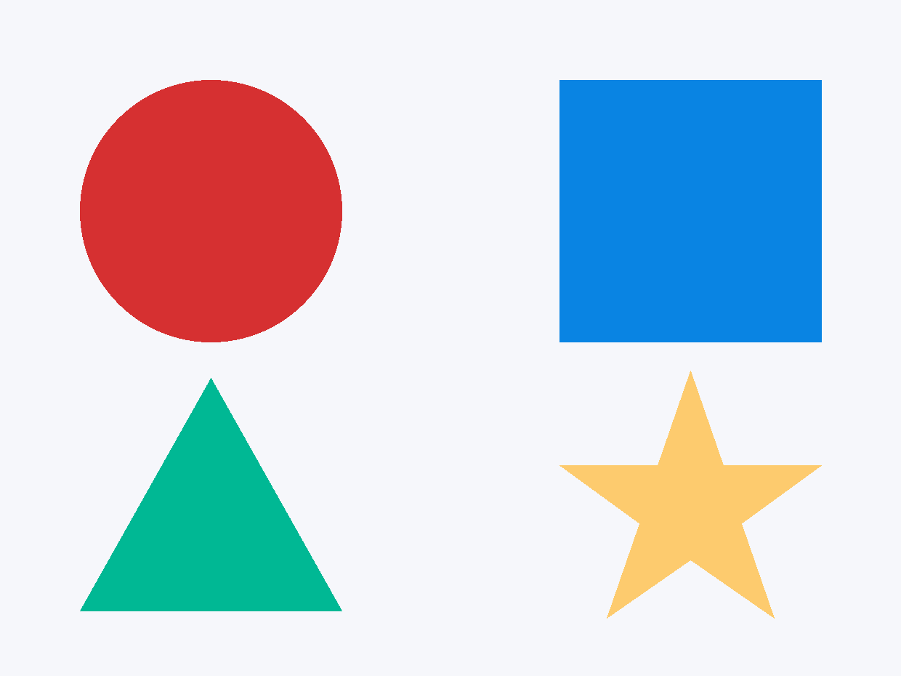
How many shapes are there in the picture?
2.a · Image · written answer
Write your answer here
Next ▶
Notes:
Written answer: the answer area shape is named sle:answer followed by the accepted answers separated by |.

Slide 3
What colour is the circle?
2.b · Image · single choice
Red
Blue
Green
Yellow
Next ▶
Notes:
Single choice: each option is named sle:option and the correct one sle:option:correct.

Slide 4
Which shapes have corners?
2.c · Image · multiple choice
Circle
Square
Triangle
Star
Next ▶
Notes:
Multiple choice: more than one option is named sle:option:correct, so the student can tick several.

Slide 5
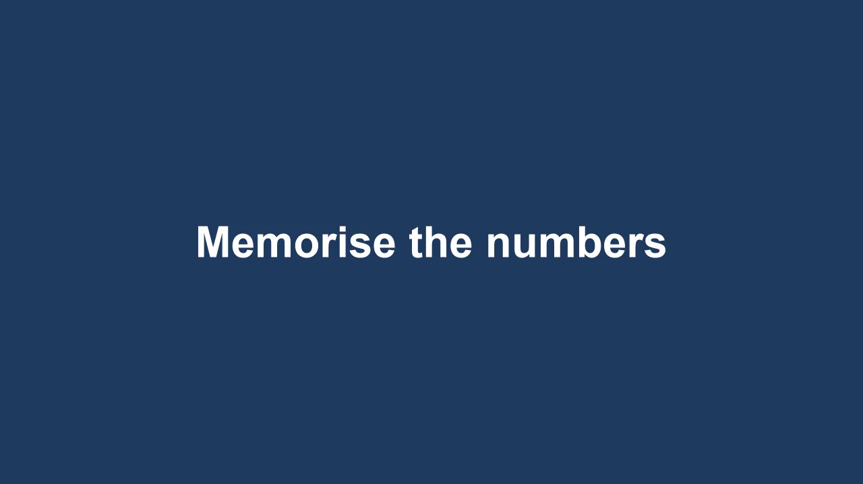
Which number appeared last?
3.a · Video · written answer
Write your answer here
Next ▶
Notes:
Written answer: the answer area shape is named sle:answer followed by the accepted answers separated by |.

Slide 6
What was the first number?
3.b · Video · single choice
3
7
9
5
Next ▶
Notes:
Single choice: each option is named sle:option and the correct one sle:option:correct.

Slide 7
Which numbers appeared in the video?
3.c · Video · multiple choice
7
5
3
9
Next ▶
Notes:
Multiple choice: more than one option is named sle:option:correct, so the student can tick several.

Slide 8

What was the last word?
4.a · Audio · written answer
Write your answer here
Press ▶ to listen
Next ▶
Notes:
Written answer: the answer area shape is named sle:answer followed by the accepted answers separated by |.

Slide 9
Which animal was mentioned?
4.b · Audio · single choice
Cat
Dog
Horse
Press ▶ to listen
Fish
Next ▶
Notes:
Single choice: each option is named sle:option and the correct one sle:option:correct.

Slide 10
Which words did you hear?
4.c · Audio · multiple choice
Apple
Table
Dog
Press ▶ to listen
Blue
Next ▶
Notes:
Multiple choice: more than one option is named sle:option:correct, so the student can tick several.

Slide 11
End of the demo!
Upload this template from your teacher dashboard, or create your own PowerPoint following the same pattern.

